Slide 1
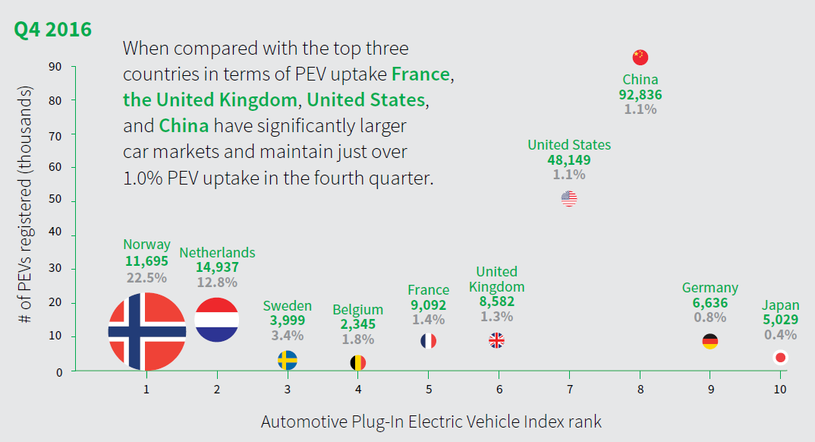

Slide 2
Briefly describe the context for the visual by addressing the following questions:
What is the source of the visual? (e.g., URL or bibliographic citation)
Who is the intended audience (i.e., decoders)? How do you know this?
1. https://viz.wtf/post/182740583010/balls-surface-area-related-to-number A misleading visual posted Feb 11th, 2019 on WTF Visualizations website( refered by Alberto Cairo’s work, Graphics Lies, Misleading Visuals) .
2. This chart is assumed to be owned by a data illustrator or analyst from a consulting team or research department, or even a project from a student. The intended audience are clients of that consulting team, crowd who are interested by PEV and intend to read it, or professors/ classmates who present a presentation.

Slide 3
Identify the specific component(s) of the visual that is/are misleading
For each part(s) of the visualization that is/are misleading, identify the mechanism that is used: hiding relevant data to highlight what benefits us; displaying too much data to obscure reality; using graphic forms in inappropriate ways (distorting the data)
Explain how the mechanisms are used to mislead
1. Actually, this chart contains all the three misleading characteristics, hiding relevant data, displaying too much data and obscuring reality and distorting data through visual forms.
2. For the 1st part of the misleading visualization, the author had hidden the relevant data of PVE registry and their time intervals. Combined by the 2nd part of the misleading visualization, the author had chosen too much useless data to obscure the views demonstrated by his real wishes. After all, the author had used graphic forms in inappropriate ways to distort the data.
3. To start with, the author had only represented the data with the fourth quarter of 2016 without any comparison to other time intervals of the study, a biased view. He had also ignored some data of PVEs registry of the leading countries, since the sample was random and France did not even own a huge car market at all, compared to others. Those hidden data cause a lot of misleading. Secondly, the author had chosen too much data which are useless, such as France and UK, contained both the average level of parameters in x, y zones and repeated without any contributions to the conclusion. Finally, the author had distorted a lot of data. His PVEs registered amounts of countries are not ordered in y-axis, such as Norway to Netherlands and France to UK, which leads to an misleading. Furthermore, the area of the circles, were not related to any plausible amounts of data. The relationship of his index rank to the leading countries are preposterous, which made no sense to any conclusion. If you straightly take a look to his arrangements, you would probably feel this chart is shipshape at the first glance. However, this charts is filled of misleading visualizations.

